Slide 1
Scm and branching
ow

Slide 2
overview
Scm
Git and github
Branch overview

Slide 3
Types
Version control systems helps developers to track, manage, and organize their code. In particular, it helps developers collaborate on code with teammates; combining features like commits and branches with specific principles and strategies.
That helps teams organize code and reduce the time needed to manage versioning.
Branching strategy determines how team approaches code branching. There are 2 different branching patterns: long-lived and short-lived.

Slide 4
Main branch
The purpose of the main branch in the Git flow workflow is to contain production-ready code that can be released.
The main branch is created at the start of a project and is maintained throughout the development process. The branch can be tagged at various commits in order to signify different versions or releases of the code, and other branches will be merged into the main branch after they have been sufficiently vetted and tested.

Slide 5
Develop branch
The develop branch is created at the start of a project and is maintained throughout the development process, and contains pre-production code with newly developed features that are in the process of being tested.
Newly created features should be based off the develop branch, and then merged back in when ready for testing.

Slide 6
Feature branch
The feature branch is the most common type of branch in the Git flow workflow. It is used when adding new features to your code.
When working on a new feature, you will start a feature branch off the develop branch, and then merge your changes back into the develop branch when the feature is completed and properly reviewed.

Slide 7
Release branch
The release branch should be used when preparing new production releases.
Typically, the work being performed on release branches concerns finishing touches and minor bugs specific to releasing new code, with code that should be addressed separately from the main develop branch.

Slide 8
Hotfix branch
The hotfix branch is used to quickly address necessary changes in your main branch.
The base of the hotfix branch should be your main branch and should be merged back into both the main and develop branches.
Merging the changes from your hotfix branch back into the develop branch is critical to ensure the fix persists the next time the main branch is released.

Slide 9
lab
Branch, merge

Slide 10
Summary of Git Flow strategy
1. A develop branch is created from main
2. A release branch is created from develop
3. Feature branches are created from develop
4. When a feature is complete it is merged into the develop branch
5. When the release branch is done it is merged into develop and main
6. If an issue in main is detected a hotfix branch is created from mai
7. Once the hotfix is complete it is merged to both develop and main

Slide 11
Branch protection
Require a pull request before merging: Enforces a workflow where developers cannot directly push changes to the main branches, ensuring all modifications go through a review process.
Require status checks to pass before merging: Configures specific status checks (e.g., unit tests, linting) that must successfully pass before a pull request can be merged.
Allow auto-merge: Enables automation for merging pull requests once all required checks and CI processes are complete. This feature allows developers to focus on other tasks while CI runs, streamlining workflows. Additionally, it is useful for automatically merging updates, such as dependency changes, when branch protection rules are enforced.

Slide 12
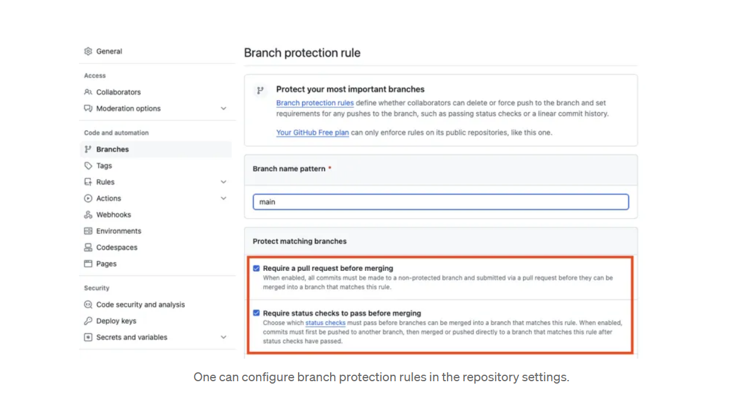
..

Slide 13
ruleset
A ruleset is a named list of rules that applies to a repository. You can have up to 75 rulesets per repository.
When you create a ruleset, you can allow certain users to bypass the rules in the ruleset. This can be users with a certain role, such as repository administrator, or it can be specific teams or GitHub Apps.

Slide 14
Lab –Ruleset
Create ruleset

Slide 15
Branch and tag ruleset
You can create rulesets to control how people can interact with selected branches and tags in a repository. You can control things like who can push commits to a certain branch, or who can delete or rename a tag.
For example, you could set up a ruleset for your repository's feature branch that requires signed commits and blocks force pushes for all users except repository administrators.

